Slide 1
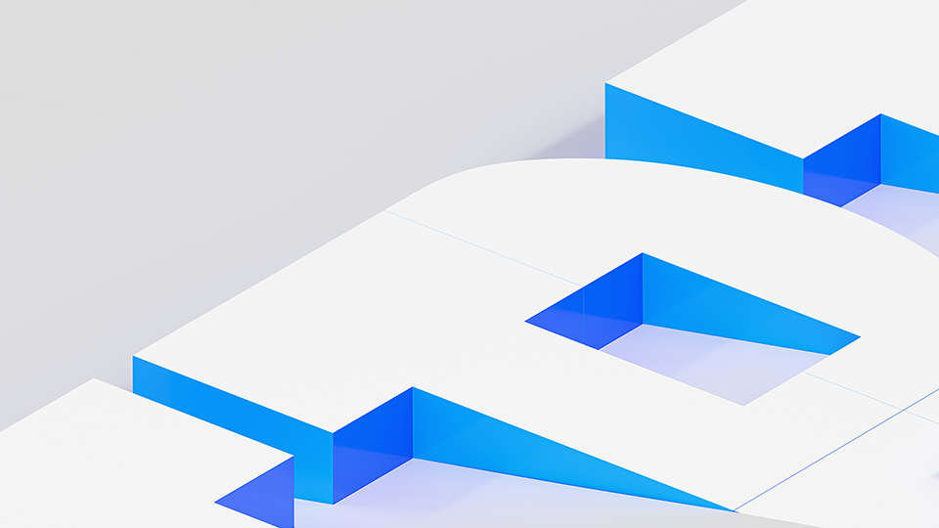
Introducing IBM’s data fabric: Seller enablement — Dirk deRoos WW Technology Sales Enablement, Data and AI dderoos@ca.ibm.com
Notes:
Today’s enterprises need an approach to data that supports self-service data exploration and questioning by their line of business decision makers. This requires organizations to overcome the limitations of time and space when it comes to their data: specifically, the locations of data, different software types, security profiles, and the list goes on. Data needs to be accessible to users who need it, not locked away behind firewalls or located piecemeal in a range of locations. Businesses need to have a secure, efficient, unified environment, and future-proof data solution in order to thrive. A data fabric architecture provides this.
This presentation is a complement to the Data Fabric 101 Client presentation (https://ibm.seismic.com/Link/Content/DC2CQDRfq8HRV8HBQ6BqM7f8PMd3) and offers guidance on how to sell IBM’s data fabric solution.

Slide 2

Content
Data fabric and related terminology
Data fabric architecture
IBM’s data fabric solution
Competitive view
Why IBM?
Notes:
This presentation provides a high-level point of view on the data fabric market and serves as a lead-in for the seller materials for the four IBM data fabric use cases (data governance and privacy, multicloud data integration, customer 360, and MLOps and trustworthy AI).
This presentation starts with a significant analysis of the major data fabric concepts and terminology, which can seem confusing and conflicting. The presentation then transitions into a review of a data fabric architecture, with a view of IBM’s solution. This will be followed by a high-level competitive view of the data fabric space. The presentation concludes with final thoughts on why IBM is the leading data fabric vendor.

Slide 3

Data fabric and related terminology
Notes:
This section features a definition of the the data fabric concept, examines how analyst definitions compare to IBM’s definition, and contrasts the data fabric concept with other related concepts that are often seen discussed alongside data fabric.

Slide 4
Data fabric terminology challenges
“Data fabric” is not like “data warehouse”, where there is a consistent understanding of the term
Analyst definitions are generally consistent, but do have notable differences
Software vendor definitions reflect their strengths and go-to-market strategies
There are multiple complementary terms:
DataOps
Data mesh
Data virtualization
Data warehouse
Data lake
Data lakehouse
Notes:
Whether you’re new to the data analytics space, or not, it feels like there is a continuous flow of new terminology being hyped by software vendors and industry analysts. The term “data fabric” is a prime example. This term is not new – it’s been used in various ways as far back as 2004 (see Google Trends: https://trends.google.com/trends/explore?date=all&q=data%20fabric). Most references to “data fabric”, until the past five years, have been in relation to vendor offerings relating to storage (NetApp), networking (Cisco), and virtual machine management (VMware) infrastructure, where the “data fabric” term was used as a marketing catch-phrase, as opposed to a commonly understood concept.
Today, there is an increasingly common understanding of what “data fabric” means, as software vendors and industry analysts have been offering largely consistent definitions of the term. However, there are still differences in how different software vendors, especially, define “data fabric”, which typically reflects their vision and their offerings’ strengths.
Adding further confusion to the data fabric space is the use of many additional terms – some of which pose similar challenges as they are new and often appear in various vendors’ marketing messaging to represent different concepts. There are also related terms that are complementary to the data fabric concept, where it is essential to understand the relation between the two concepts. Listed here are a set of terms that are frequently used in a complementary manner to “data fabric”. The following slides will establish definitions for these terms and describe their relation to the “data fabric” concept, but first there will be a level-set of IBM’s definition and positioning relative to today’s major analyst perspectives.

Slide 5
IBM definition of data fabric
A data fabric is an architectural approach to simplify data access in an organization to facilitate self-service data consumption.
This architecture is agnostic to data environments, processes, utility, and geography, all while integrating end-to-end data-management capabilities.
A data fabric automates data discovery, governance, and consumption, enabling enterprises to use data to maximize their value chain.
With a data fabric, enterprises elevate the value of their data by providing the right data, at the right time, regardless of where it resides.
https://www.ibm.com/analytics/data-fabric
Notes:
IBM’s official definition for fabric can be found at this site (https://www.ibm.com/analytics/data-fabric) in the section titled “What is a data fabric?”.
There are four distinct parts of this definition:
“A data fabric is an architectural approach to simplify data access in an organization to facilitate self-service data consumption.” There are two things that stick out in this opening sentence: First, it specifically defines a data fabric as an architecture. It’s not a product or services offering, a standard, nor a technology. Second, it outlines the purpose of a data fabric, which is to enable self-service access to data and the ability to use it. This speaks to the critical need of data-driven organizations that their line of business people need to be able to ask new questions against the organization’s data.
“This architecture is agnostic to data environments, processes, utility, and geography, all while integrating end-to-end data-management capabilities.” With part one, it’s understood that data fabric is an architecture, and its purpose in facilitating self-service data consumption. This second part of the definition speaks to the problems all organizations are experiencing, which is that their data (which is spread across different systems, stored in different formats, and subject to different processes) is simply not consumable for self-service use cases. A data fabric integrates access to data regardless of these different kinds of barriers. It provides further integration to support the capabilities needed for the data analytics life cycle stages: searching for data, exploration, preparation and refinement, and data product development (where a data product is something as simple as a derived data set with calculated values, or an interactive dashboard, or a machine learning model).
“A data fabric automates data discovery, governance, and consumption, enabling enterprises to use data to maximize their value chain.” Where parts one and two describe why organizations need a data fabric and what it works against, this third part of the definition describes how the implementation of a data fabric needs to work. In short, the key to a sustainable data fabric is AI-driven automation. In listing “discovery, governance, and consumption”, this definition specifically spells out the activities where automation is needed: - Discovery: data sets are continually being created and modified, so automated discovery and metadata extraction is needed to ensure that the data catalog is kept current. Manual data discovery efforts tend to be error-prone and unsustainable. - Governance: even small and medium sized enterprises have enough data sets and repositories that manual governance efforts would be impractical. Automated governance empowers data stewards to define classes of data and corresponding data access rules, which ensures that access to data sets or specific fields needs to be restricted (for example, customer data can be subject to data privacy regulations, or financial performance information is highly confidential). - Consumption: As business users explore data and create their own derivative data products, automated processes track these activities for security and regulatory reasons, and also to support the discovery of these newly created data products. For example, a line of business team built a lead qualification model for prospective auto insurance customers, which was added to the knowledge catalog; later, the home and property insurance team had a similar need, and upon finding the auto insurance lead qualification model, were able to trace this model’s lineage, and reuse many of the same data sets and preparation stages as they built their own lead qualification model.
“With a data fabric, enterprises elevate the value of their data by providing the right data, at the right time, regardless of where it resides.” This final line is the conclusion of IBM’s data fabric definition, which summarizes the purpose of a data fabric architecture: the “right data” not only refers to data that’s needed in self-service data consumption, but it also refers to the notion of sensitive data, which proper governance approaches prevent it from being accessed.

Slide 6
Data Fabric definitions from Gartner and Forrester IBM’s definition is mostly aligned
More emphasis on active metadata and knowledge graphs
More emphasis on security, trust, governance
Gartner
Forrester
Streaming analytics
Data processing
Data persistence
Embedded AI/ML
ETL / data transformation
Data catalog
Data ingestion
Data preparation
Data quality
Knowledge graphs
Metadata
Data lineage
Data policies
Data privacy
Data security
Active metadata
Data virtualization
Common threads
It’s an architecture
Embedded AI is critical
Key capabilities span data integration and governance
Connects disparate data
Master data management
IBM
More emphasis on data access, hybrid cloud
Notes:
In recent years, the definition of “data fabric” has evolved considerably to a point where the definitions adopted by industry analysts is mostly consistent. This slide shows a Venn diagram that captures the characteristics of data fabric architectures from the perspective of Gartner, Forrester, and IBM. What’s encouraging is that there are far more similarities than differences in these definitions, and there is consistency for the most important elements.
All three of Gartner, Forrester, and IBM agree on the following common concepts for data fabric:
Data fabric is an architecture, and not a product or set of services
Automation (enabled by embedded AI models) to support discovery, governance, and consumption is critical
Data fabric capabilities span the domains of data governance and data integration
The purpose of data fabric architectures is to support self-service access to data stored in different locations and formats
While this slide presents many of the finer details of these organizations’ data fabric definitions, there are two important conclusions to be drawn from this slide:
There is broad enough agreement on the data fabric definition that people selling IBM’s data fabric solution don’t need to dwell on the finer points of the definition
The primary focus for people selling IBM’s data fabric solution needs to be demonstrating IBM’s capabilities to support a data fabric
Sources:
Forrester article “Enterprise Data Fabric Enables DataOps” – link: https://www.forrester.com/report/enterprise-data-fabric-enables-dataops/RES153219?RegId=1-WMA0VN&objectid=RES153219
Gartner article “Data Fabric Architecture is Key to Modernizing Data Management and Integration” – link: https://www.gartner.com/smarterwithgartner/data-fabric-architecture-is-key-to-modernizing-data-management-and-integration

Slide 7
DataOps workflow
Raw data
Refined data
Business-ready data
Build infrastructure
Organize and structure
Explore and profile
Transform
Model
Operationalize
Govern
Consume
Data architect
Data engineer
Data analyst
Data analyst
Business user
Data engineer
Data scientist
Data architect
Data steward
Notes:
Data operations (DataOps) is the orchestration of people, process, and technology to deliver trusted, high-quality data to data citizens fast. The focus for DataOps is on enabling collaboration across an organization to drive agility, speed, and new initiatives at scale. DataOps helps organizations show the value of data by optimizing decisions and time. In other words, DataOps is a practice, not a technology.
This slide shows all the stages in a typical DataOps workflow, where the end-result of a given project is a data pipeline that takes raw data and refines it into a business-ready state. Orchestration is needed, as many user personas with complementary skills are involved in the building of any data pipelines, especially where multiple stages of the workflow are iterative, where different personas exchange portions of the data pipeline as they drive toward solutions.
To experience the benefits, the internal culture needs to evolve to truly be data-driven. With more business segments requiring and wanting to manage data to drive contextual insights, the time is right to do the following:
Increase the quality and speed of data flowing to the organization.
Obtain commitment from leadership to support and sustain a data-driven vision across the business.
This type of transformational change begins by understanding the true goals of the business, which can be found by answering the following questions:
How does data inform the decisions and services impacting customers?
How can data help maintain a competitive advantage in the market?
What are the financial priorities that data can help a client solve?
DataOps leaders should define the roles all data citizens play to drive the culture and the DataOps practice moving forward. Each organization has unique needs where stakeholders in IT, data science, and the business lines need to add value to drive a successful business. Also, leveraging existing data governance committees and learnings from tenured data governance programs helps establish this culture and commitment as governance is one of the driving forces needed to support DataOps.
Source:
IBM whitepaper “Deliver business-ready data fast with DataOps” – https://www.ibm.com/downloads/cas/GLNAZBXN

Slide 8
DataOps and data fabric
Data operations (DataOps) is the orchestration of people, processes, and technology to deliver trusted, high-quality data to data citizens fast.
Data fabric architectures need an agile and effective DataOps practice
DataOps is the booster for a data fabric solution, ensuring that those components are used to their full potential to facilitate self-service data exploration and experimentation.
Notes:
Data operations (DataOps) is the orchestration of people, process, and technology to deliver trusted, high-quality data to data citizens fast. The focus for DataOps is on enabling collaboration across an organization to drive agility, speed, and new initiatives at scale. DataOps helps organizations show the value of data by optimizing decisions and time. In other words, DataOps is a practice, not a technology.
A data fabric architecture is the setting that facilitates a healthy DataOps practice. Building agile and successful data pipelines needs both an architecture that supports self-service consumption (regardless of where or what format the data is in), and orchestration best practices.
To give an analogy, an airline’s goal is to not only have highly efficient airplanes, but to also have those planes depart and arrive on time and maintain an organized schedule. (It might not feel like it, but airlines pay many thousands of dollars in “gate fines” to airports when they are responsible for delays.) If a data fabric is the data corpus of an airline’s fleet of highly efficient airplanes, then it also needs the well-organized processes of DataOps to most efficiently run the airline and make sure all components are used to their full potential.
Source:
Forrester article “DataOps For The Intelligent Edge Of Business” – https://www.forrester.com/report/dataops-for-the-intelligent-edge-of-business/RES162717?objectid=RES162717

Slide 9
Data mesh principles
Domain ownership
End-to-end data ownership belongs to the applicable line of business teams and departments
Data as a product
Data needs to be tied to business goals and the value they generate
Self-service data infrastructure
Any data consumer, regardless of role must have easy access to the data they need
Federated computational governance
Enables self-service for easy end user data consumption and collaboration
Notes:
In 2019, Zhamak Dehghani (a consultant at ThoughtWorks) published a whitepaper that defined a blueprint for an emerging concept, known as a data mesh. This concept has gotten increasing traction as analysts have given it significant attention and IT software vendors (most notably DataBricks and Oracle) have promoted their services as being ready to support the data mesh concept.
The data mesh concept originated out of the struggles organizations were having with data lake technologies, as a common problem emerged, where the focus of data lake initiatives was heavily applied to a centralized model of data management and on infrastructure, as opposed to the support for line of business goals.
The data mesh concept can be understood through four principles:
Domain ownership: Rather than have self-service analytics practices be driven by a central IT team, end-to-end data ownership belongs to the applicable line of business teams and departments.
Data as a product: Data needs to be explicitly tied to business goals and the value generated by these goals. This value is commonly measured in terms of impact on revenue or expenses, but needs to be applied to how the line of business teams measure value. This means an organization’s perspective is on the end-result of what’s generated by a data pipeline (for example, a trained machine learning model or an interactive dashboard), and how the specific data product is tied to business value (for example, a model that predicts late payments).
Self-service data infrastructure: This is a technology agnostic principle, as it simply defines the technical requirement that any user persona involved in a data pipeline has self-service access to whatever data they need. Many potential data architecture can fulfil this requirement.
Federated computational governance: With domain-specific ownership, there is a risk that a data mesh implementation would result in the development of an increased numbers of data silos, which was the original problem the data lake was intended to solve. To avoid silos and to ensure sustainable data analytics practices, data governance must be applied to the domain or line-of-business-specific data practices. This ties back to the “data as a product” concept, where for a data product to be legitimate, it needs to be findable, consumable, and understood by other lines of business. A central data catalog is frequently the technical solution where line of business teams publish their data products, and where other teams can find them.
The summary point here is that the data mesh concept inverts the traditional centralized IT approach to data management and analytics, to a decentralized and distributed approach that revolves around line-of business teams and their business goals.
Sources:
Thoughtworks white paper titled “How to Move Beyond a Monolithic Data Lake to a Distributed Data Mesh” – https://martinfowler.com/articles/data-monolith-to-mesh.html
SiliconAngle article titled “Data mesh: a new paradigm for data management” – https://siliconangle.com/2021/10/27/data-mesh-new-paradigm-data-management/

Slide 10
Data mesh and data fabric
Data mesh is an approach centered on organizational processes to enable agile, domain-specific ownership and creation of reusable data products. It is technology agnostic and domain owners are responsible for the entire data lifecycle.
Data fabric is a technology architecture, while data mesh represents processes and principles – not technology; these are not competing concepts.
As the end-goal of both data fabric and data mesh is to facilitate self-service data consumption, a data fabric architecture can be the implementation layer that supports data mesh processes.
Notes:
To recap: data mesh is an approach centered on organizational processes to enable agile, domain-specific ownership and creation of reusable data products. It is technology agnostic and domain owners are responsible for the entire data lifecycle. The primary focus of the data mesh approach is on data products, which are intended to serve a line of business audience.
Data mesh represents a set of principles and processes that define an organization’s approach to data and analytics. As the end-goal of both data fabric and data mesh is to facilitate self-service data consumption, a data fabric architecture can be the implementation layer that supports data mesh processes In fact, IBM supports multiple clients who are adopting data mesh principles with data fabric architecture deployments. Since a data mesh approach requires a facility where line of business teams can publish their data products and where other teams can find them, this is an opportunity to propose Watson Knowledge Catalog to organizations who are interested in data mesh.
Regardless of the terminology used by a client and what theories of data analytics they favor, the goal needs to be a focus on client needs. No enterprise is starting their data analytics practice from scratch, and few have the luxury of implementing ideal systems. The key to client success will be communicating to a client how IBM’s data fabric solution offerings can provide self-service access and consumption of data (which can be left in-place), all through an AI-infused intelligent governance framework that balances the needs for business users to “shop for data” with the needs of the Chief Data Office, which ensures that sensitive data is protected.
Sources:
Forrester blog post: “Exposing The Data Mesh Blind Side” - https://www.forrester.com/blogs/exposing-the-data-mesh-blind-side/
IBM blog post: “Augmented data management: Data fabric versus data mesh” – https://www.ibm.com/blogs/journey-to-ai/2022/04/augmented-data-management-data-fabric-versus-data-mesh/

Slide 11
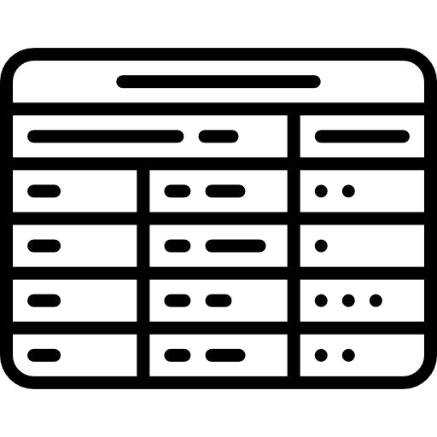
Data virtualization
A tool that enables physical data from various sources to be represented in a virtual manner so that the data can be viewed, accessed, manipulated, and analyzed, without the need to know or understand its physical format or location, and without having to move or copy it.
Virtual tables representing physical data
Connect, access, and govern any data without the need for data movement
Abstract complexity from data consumers
Create virtual views over multiple data sources
Governance integration and security
Physical tables
Notes:
Traditionally, data integration solutions have replicated copies of data from disparate sources into a separate consolidated target system. Query performance benefits from having collocated data in a single location but maintaining multiple copies of data comes at a cost, quite literally. There are the obvious storage costs, as well as the personnel and processing costs of implementing and maintaining replication pipelines to ensure that the data is extracted, transformed, and loaded (ETL) into a format that is useable on the target system – and executed frequently enough to maintain data currency. Data replication also introduces additional security and governance concerns. How easy it for consumers of the data to understand its lineage and trust that it’s current and accurate? With multiple copies of the data now in multiple locations, it becomes complicated and error prone to ensure that people are only accessing and seeing data that they’re supposed to.
Data virtualization addresses these issues. Data virtualization is the act of representing remote data as a local object, leveraging pushdown optimization (do as much of the query processing as possible at the original data source), and pulling only what’s needed on-demand, then caching when appropriate for faster performance. This allows applications to retrieve and manipulate data without requiring technical details about the data, such as how it is formatted at source, or where it is physically located.
https://ibm.seismic.com/Link/Content/DCqF86J2DTJPj8HPgpQBTXBj3Jq3
Benefits of data virtualization include:
No need for additional storage for a replica.
Simplified complexity around data management.
Unified access control and governance for all attached systems (a common data governance and data access control plane).
Ability to join data from systems that would otherwise be impossible.
Common SQL interface for all coonected database systems, which means there is no need to know the SQL dialect for the target database.
By using the processing power of every data source and accessing the data that each data source has physically stored, latency from moving and copying data is avoided. In addition, all repository data is accessible in real-time, and governance and erroneous data issues are virtually eliminated. There’s no need for ETL and duplicate data storage, accelerating processing times. This process brings real-time insights more quickly and dependably than existing methods.
The diagram on the right-hand side of this slide represents the high-level architecture of a data virtualization deployment. Users and applications can connect to the data virtualization service (which provides access to the virtual tables representing physical data) to browse virtual tables and views as if they are tables in a local database. Users can also create virtual views, which represent combinations of data from different sources (again, regardless of location) and from the user’s perspective looks like an ordinary table in a local database.

Slide 12
Data virtualization and data fabric
Data virtualization connects multiple data sources across locations and turns all this data into virtual data views. These read-only data views enable users to view, access, and analyze data without knowing its location.
Data virtualization is a key technology in data fabric architectures.
Data fabric architectures provide self-service access to data, regardless of location or format. This requires automated, easy-to-use data integration tools including data virtualization.
Notes:
To recap, data virtualization is a tool that provides the ability to view, access, and analyze data without needing to know its location. Data virtualization can integrate data sources across multiple data types and locations, turning it into a single logical view without having the need to do any sort of data replication or movement.
Data virtualization is a key technology in IBM’s data fabric solution, given its ability to make data available for self-service users, regardless of its location or format. IBM provides data virtualization capabilities in the Watson Query service from IBM Cloud Pak for Data. Applications connect to the Watson Query service and access virtual tables and views as if they are tables in a local database. However, in practice these virtual objects represent data stored in remote disparate data sources. To optimize query performance, users can create local caches, where data and results can be saved to accelerate query processing. Users can determine the frequency at which these caches are refreshed.
Watson Query features native integration with Watson Knowledge Catalog (WKC), which permits the enforcement of polies setup by WKC (such as the masking of sensitive data) and allows sharing of the data in a fully governed way – providing the foundation for self-service data access.

Slide 13
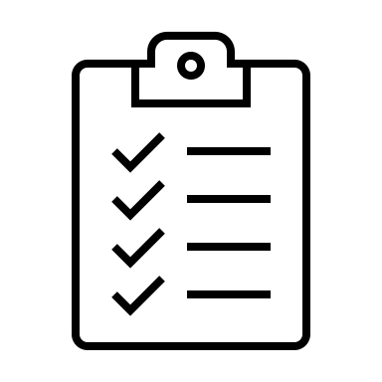


Data warehousing
Reporting
Extract, transform, and load
Visualization
Data warehouse
Transactional databases (systems of record)
Machine learning
Notes:
A data warehouse, or enterprise data warehouse (EDW), is a system that aggregates data from different sources into a single, central, consistent data store to support data analysis, data mining, artificial intelligence (AI), and machine learning. A data warehouse system enables an organization to quickly run powerful analytics on huge volumes (even at petabyte scale) of historical data in ways that a standard database cannot.
Each enterprises captures the state of their business in transactional databases – for example, when you make a deposit in your bank account, the transaction is captured in a fast, secure way in your financial institution’s database system. Continuing with the bank analogy, with potentially millions of customers issuing financial transactions, transactional (or operational) database systems are optimized so that the ever-changing state of each customer’s account is captured as quickly as possible. However, the financial institution has a need to do analytics against all these transactions – both for regulatory reporting, and for their own business development purposes. The problem is that the transactional database system is not optimized for the complex kinds of questions being asked against the data from the reports and dashboard visualizations. The solution here is a data warehouse: a system that is dedicated to hosting data in specific formats that support reports, visualizations, machine learning model training, and whatever other applications are needed. Where the transactional database system is designed to quickly and reliably capture changes to the state of the business, a data warehouse system is designed to answer specific questions quickly.
To get data from the transactional databases into the data warehouse, data engineers craft data pipelines that regularly refresh the data in the warehouse (for example a nightly batch run). The data operations in a data pipeline are known as ETL, which is short for “extract” (capture the data from the transactional system), ”transform” (convert the data into a state where it can support the questions from the reports and applications), and ”load” (move the data into the warehouse).
Data warehousing systems have been a part of business intelligence (BI) solutions for over three decades, but they have evolved recently with the emergence of new data types and data hosting methods. Traditionally, a data warehouse was hosted on-premises and its functionality was focused on extracting data from other sources, cleansing and preparing the data, and loading and maintaining the data in a relational database. More recently, a data warehouse might be hosted on a dedicated appliance or in the cloud, and most data warehouses have added analytics capabilities and data visualization and presentation tools.

Slide 14
Data warehouses and data fabric
A data warehouse contains data pulled together from different sources into a single data repository, where the data is structured to answer specific queries from analytics applications like dashboards, reports, or machine learning training pipelines.
A data fabric architecture includes data warehouses as data sources.
Data warehouses contain cleansed and modeled data, while created for specific applications still has broad appeal for line of business users who are asking different questions.
Notes:
To quickly recap, a data warehouse exists to support data analytics applications, like dashboards, reports, and training data sets for production machine learning models. Data warehouses contains data pulled together from different sources into a single data repository, where the data is structured to answer specific queries from the data analytics applications.
Data warehouses are expensive to run as the performance expectations for data analytics applications are high. Data warehouses have large volumes of data that need to be stored on fast storage layers (which are expensive). Although many data management vendors have talked about emerging technologies and architectures eventually replacing the data warehouse (for example, data lakes), this is unlikely to happen. As long as business users need high performance reports and dashboards to support their decision making, there is no low-cost alternative to data warehouses available that can accomplish comparable performance characteristics.
A data fabric architecture works with established data pipelines and sources, and, as such, includes data warehouses. For exploratory use cases where business analysts might need the high-quality cleansed data from a data warehouse system to run some experimental queries, data fabric technologies like data virtualization can be used to keep the warehouse data in-place, while providing the exploratory user an opportunity to explore this data in an efficient manner with only minimal impact on the warehouse system’s performance. It’s important to note here that these experimental questions do not have the same performance expectations of an established dashboard or report. Where reports and dashboards are typically responsive within seconds, experimental queries can take minutes or longer.

Slide 15
Data lake architecture
Reporting
Ingestion zone
Discovery zone
Raw data
Refined data
Visualization
Annotated data
Raw data
Guided analytic zone
Machine learning
Refined data
Transactional databases (systems of record)
Data warehouse
Notes:
A data lake is an architecture where data from across the enterprise is stored in a central location on low-cost hardware. The idea is to expose data previously held in “data silos” that were only able to support applications for a specific line of business. Similar to a data fabric, the goal of a data lake is to facilitate self-service access to data for people who need to experiment and ask new questions.
In addition, enterprises are facing the reality of having to store data in much higher volumes, and in different formats than was common in previous years. For example, web and mobile apps often store their data in document databases, which are completely different than the relational database systems many data engineers and IT professionals are used to. With the increasing volumes of data and varying formats, the data lake architecture represents a cost-effective and flexible solution.
For businesses, the challenge was to find a way to incorporate the information in document databases for mobile apps with their traditional business data, such as customer and sales information. This would provide an enriched view of their customers’ buying habits, and it would help a company make more targeted and strategic decisions on how to increase business.
This dilemma produced the concept of the data lake. A data lake is, essentially, a large holding area for raw data. They are low cost, highly scalable, and able to support extremely large data volumes and accept data in its native raw format from a wide variety of data sources.
The data lake technology of choice has primarily been Apache Hadoop (an open-source project). Hadoop supports the storage of combinations of both structured and unstructured data. Hadoop is essentially the marriage of a massive parallel file system and a massive parallel data processing system.
In a data lake, data from a variety of sources is captured and stored in an ingestion zone. Because of the large-scale parallel processing capabilities of Hadoop, many enterprises have actually moved their ETL (extract, transform, load) processing into Hadoop, and move the resulting refined data into their high-performance data warehouses. This refined data is still available in the data lake itself in a guided analytic zone for people to explore. Having people explore warehouse data in the data lake instead of the warehouse offloads potentially expensive and disruptive workloads from data warehouse systems. The data lake also has a discovery zone, where data engineers and data analysts can experiment by building new data pipelines that would support potentially useful reports, dashboard visualizations, or machine learning models.
In past years, some analysts and software vendors have openly talked about data lake technologies replacing data warehouses. In looking at this picture, it is clear that a data lake can technically provide data to support reports, interactive dashboards, and machine learning model training data sets. But the important distinction here is whether, or not this is a practical solution. Data warehouses run on expensive hardware and are designed to support sub-second response times for mission critical business applications. Data lake technologies like Hadoop are highly flexible and scalable, but they are not optimized for high-performance query execution. With this in mind, look at the data lake as a place for exploratory and experimental analytics, where there’s a tolerance for issuing a query and waiting for some minutes for it to finish.
Finally, a healthy data lake must have an enterprise data catalog to support the automated discovery, governance, and consumption of data. Without a commitment to data governance, data lakes will quickly devolve into data swamps.

Slide 16
Data lakes and data fabric
A data lake is a lower-cost system (than data warehouses) designed to store large volumes of data in different formats.
As a data source for data fabric architectures, data lakes can be a sandbox where experimentation work happens.
Data fabric architectures can use data lakes to provide efficient, cost-effective access to data that is otherwise only available from production systems.
Notes:
To quickly recap, a data lake is a low-cost system (the alternative here is a data warehouse, which is expensive) that’s designed to store large volumes of data in a variety of formats. One of the main goals of a data lake is to facilitate experimental analytic work.
On first blush, it can look like the data lake architecture is in competition with data fabric. Coming back to a core part of the data fabric definition “providing the right data, at the right time, regardless of where it resides,” there are multiple ways this can be facilitated, and a data lake implementation can be a possibility. Similar to a data warehouse, a data lake can be a rich source of data within a data fabric, and also a place where the data processing work involved in exploratory data analytics happens.
While it was once at the top of the “hype cycle,” the data lake concept no longer has the same appeal, and because of some rushed implementations it has a mixed reputation. Many early Hadoop-based data lake deployments were not well governed, and led to the “data swamp” phenomenon, where the data lake became a place where there were many undocumented copies of the same data in various states of transformation. A data lake embedded in a data fabric architecture would be set up for better results as the governance and metadata management layer in the data fabric would provide cataloging and lineage for all data in the lake. As such, Watson Knowledge Catalog represents a potential means to deliver value for existing data lake deployments; by automatically capturing metadata for data in a lake, Watson Knowledge Catalog can generate active metadatawill provide an improved experience for users searching for data sets.

Slide 17

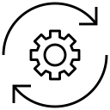
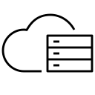
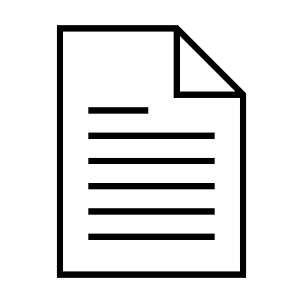
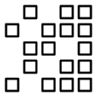
Data lakehouse architecture
Reporting
Visualization
Machine learning
Governance framework
Data processing
Structured data
Document data
Unstructured data
Cloud object storage
Notes:
The data lakehouse concept is a relatively new one, having gained popularity since 2020. The idea is simple: a single system with the performance characteristics of a data warehouse, but with the inexpensive and flexible storage of a data lake. Databricks, AWS, and Dremio are the main vendors who have spearheaded much of the momentum in this area, providing data lakehouse offerings to their customers.
In 2021, 451 Research has found that “two-thirds of companies are already using or piloting a data lakehouse environment, or plan to do so within 12 months.” In addition, they found that 93% of organizations that have embraced data lakes also plan to adopt a data lakehouse in the next 12 months.
For people who have been following the evolution of Hadoop and data lakes, an immediate question that comes to mind is this: “Isn’t a data lakehouse just a more modern data lake?” In a sense, yes, it is. But there are specific characteristics for the data lakehouse pattern, where it does make sense to use this as a term to describe a particular kind of data lake. Here are these specific characteristics:
Cloud object storage is the storage layer: Cloud object storage has emerged as one of the most inexpensive means to persist data. Adding to its appeal as a storage medium is massive scalability, extremely high reliability, and a high degree of flexibility for storing many kinds of data.
Open-source storage formats: While cloud object storage is place where the data is stored, it needs to be structured in a manner that it can later be queried. Where data warehouses store data in formats that are proprietary to the database vendor, a core principle of the data lakehouse is open storage. Open-source file formats for structured (or semi-structured) data like Parquet are commonly used here.
Data processing: This is where the “data warehouse”-like experience in the data lakehouse comes in, which is provided by standard SQL interfaces to data in cloud object storage.
Governance layer: A key element of data warehouses is a high degree of structure and cleanliness of the data. While data in a lakehouse is be in various states – some of it raw and unrefined, and some of it cleansed and prepared for polished reports – a strong governance layer is essential for managing data and pipelines as data moves into its various states.
Obviously a data lakehouse will not achieve the same performance characteristics of a data warehouse, which is a highly optimized system with fast storage and expensive processors. But the expectations and needs for performance in self-service exploratory analytics are not nearly as high as for production-state reporting and analytics.
Source:
451 Research report “The data lakehouse is now official – what it is and why you should care” – https://clients.451research.com/reportaction/101063/Toc

Slide 18
Data lakehouses and data fabric
A data lakehouse is a cloud-based data architecture designed to support the best of both the data lake and data warehouse worlds: inexpensive, high-volume, and flexible storage, and support for high-performance SQL-based workloads.
A data lakehouse is a supporting technology in a data fabric architecture, where it is both a data source and sandbox for experimentation.
Data fabric architectures can use data lakes to provide efficient, cost-effective access to data that is otherwise only available from production systems.
Notes:
As a quick reminder, a data lakehouse is a cloud-based data architecture designed to support the best of both the data lake and data warehouse worlds: inexpensive, high-volume, and flexible storage, and support for high-performance SQL-based workloads. Similar to data lakes, the data lakehouse can be a powerful enabling technology in a data fabric architecture. Also similar with data lake technology, there are many people talking about using data lakehouses to replace data warehouses. While some data warehouses might be replaced with this lower-cost alternative, where there continues to be a need for high-performance production-oriented analytic workload support, data warehouses will continue to be the most appropriate choice.
Regardless of the hype, there is no escaping the basic concept that enterprises need different systems for production work (like a data warehouse that supports established analytics) and for experimental work (like a data lakehouse that supports exploratory analytics). A data fabric architecture marries the production and exploration worlds so that users have access to all their enterprises’ data.
IBM is investing heavily in the data lakehouse concept, with a product offering on the horizon for early 2023, which expands considerably on IBM’s Big SQL and data virtualization technologies.
Sources:
https://www.ibm.com/cloud/blog/data-virtualization-the-evolution-of-the-data-lake
https://www.ibm.com/cloud/learn/data-warehouse

Slide 19
Elements of a data fabric design for data-driven organizations
Data consumers
Self-service
Augmented knowledge
Smart integration
Multi-modal data governance, security, and compliance
Unified lifecycle
Find, collaborate, and access to high-quality data assets
Unified view of data and metadata with actionable insights
A range of policy-driven integration styles with intelligent automation
Unified definition and enforcement of data governance policies
End-to-end lifecycle to build, test, deploy and manage the data fabric
IBM Cloud
AWS
Microsoft
Google
Edge
Private
Data sources
Notes:
To be successful, data-driven organizations much include five essential components within their data fabric architecture. To deliver on the principle of simplifying data complexity, and achieving the goal of quickly delivering trusted and governed data to data consumers, no matter where it resides, and in what format, the data fabric must seamlessly, and comprehensively provide the following capabilities:
Self-service: This is the goal of a data fabric. The data fabric must provide a trusted and governed marketplace for data consumers to easily search, find, understand, collaborate, and gain access to data assets and data products so they spend less time looking for and preparing data and more time gaining insights and providing value for the business through analytics and AI. For example, by providing a global search, and end user looking for employee data, could simply type in the word “employee” and find all data assets they have access to that exists in catalogs and projects, that has anything to do with the word “employee” in seconds. That is a huge time savings and that is self-service.
Augmented knowledge: At the heart of a data fabric architecture is an abstraction layer of augmented knowledge, a unified view of data and metadata that provides a common business understanding of the data with insights derived from intelligent automation to act on those insights. For example, automatically profiling, classifying, and assessing data quality without any human or manual intervention as data assets are added to the catalog.
Smart integration: Everything starts with data. Therefore, the data fabric must provide a wide range of integration styles and techniques to extract, ingest, stream, virtualize, and transform data across an extensive library of hybrid cloud data sources, that is driven by automation and data policies, to maximize performance while minimizing storage and egress costs. For example, a data engineer can define a global set of data source connections that can be used by data consumers to virtualize, integrate, replicate, and prepare data that are all aware of and adhere to data protection rules defined by the data steward to detect and protect sensitive data.
Multi-modal data governance, security, and compliance: Unified definition and enforcement of data policies, tied to the knowledge layer, where one to many policies can be combined throughout the end-to-end unified lifecycle of the fabric for data stewardship of governance, security, and compliance. For example, a data steward can easily define and enforce data protection rules to automatically govern and protect data whether it is virtualized, cataloged, or used in a project for analytics and AI.
Unified lifecycle: There must be an end-to-end lifecycle to compose, build, test, deploy, and manage the various aspects of the data fabric. For example, a full spectrum of end-to-end integrated capabilities to compose, deploy, and manage a data pipeline or a machine learning model. As data products are developed, the catalog captures metadata about where the prepared data originally came from and the changes applied to it; this metadata is known as lineage.

Slide 20
IBM’s data fabric solution within IBM Cloud Pak for Data
Data consumers
Self-service
Augmented knowledge
Smart integration
Multi-modal data governance, security, and compliance
Unified lifecycle
Watson Studio
Watson Query
Watson Knowledge Catalog
Match 360
Master Data Management
Watson Query
DataStage
Data Replication
Watson Knowledge Catalog
Guardium
Cloud Pak for Data foundation
Watson Studio pipelines
IBM Cloud
AWS
Microsoft
Google
Edge
Private
Data sources
Notes:
A data fabric enables better use of data as an enterprise asset by helping organizations access the right data, just in time, regardless of where the data is stored, so they can reduce the costs and risks of data management.
Data fabrics are agnostic to the deployment platform, data process, data use, geography, and architectural approach. They provide business-ready data to support applications, analytics, and business process automation by dynamically orchestrating disparate sources across a hybrid and multi-cloud landscape.
IBM Cloud Pak for Data enables a distributed, hybrid, and multi-cloud data fabric with embedded governance and intelligent automation of core workflows allowing access to the right data across any cloud and on-premises environment just in time to deliver trusted outcomes with AI initiatives. Attached to the catalog are security and compliance, and lifecycle management services to ensure that data is clean and valid. And all of this enables clients to apply industry-specific governance rules in a matter of minutes across the enterprise by using active metadata to enable automatic policy enforcement for any data access. In short, Cloud Pak for Data provides organizations with set of integrated self-service tools to provide all users with the ability to find, explore, and ask questions against all available data.
IBM Cloud Pak for Data products and services are represented in every aspect of the data fabric. The Cloud Pak for Data foundation services that provide orchestration and lifecycle functions as well as security and compliance are incorporated, integrated, and shared across the platform and used in all three of the essential components of the data fabric. Also notice that every layer of the data fabric is integrated with each other allowing them to share resources, events, information assets, data assets and metadata with continuous communication across the data fabric.
Following are the main services that make up Cloud Pak for Data:
Watson Studio is a collaboration tool for users of varying skill levels to build and train AI and machine learning models and prepare and analyze data.
Watson Query is the data virtualization service, which makes queries across multiple data sources faster and easier without moving your data.
Watson Knowledge Catalog features an automated governance facility that gathers metadata from disparate sources to establish a single, trusted, view, which users can explore on a self-service basis.
Match 360 consolidates data from disparate sources to establish a single, trusted, view of customers.
DataStage is a graphical environment for DataOps work where users can build and maintain data pipelines.
Watson Query and Watson Studio are the key contributors to providing Self-Service capabilities to applications, data consumers, and through application programming interfaces (APIs). Watson Knowledge Catalog, Match 360, and Master Data Management (MDM) are the core components of the Augmented Knowledge layer. Watson Query, DataStage, and Data Replication with Kafka and the Event Store provide the intelligent Smart Integration layer; these are the orchestrators and manage the multi-cloud hybrid data sources supported throughout the data fabric.

Slide 21
How does IBM’s data fabric solution fit into an organization’s tool landscape?
Fully integrated stack based on Cloud Pak for Data
Use multi-vendor tools and storage with an IBM data fabric
Use different tools and storage with a mixed data fabric and federated catalogs
Notes:
IBM’s data fabric solution can fit into any organization’s landscape. Since the data fabric can enable self-service for applications and tools, organizations’ applications do not all need to be implemented using Cloud Pak for Data. For example, the fabric supports open standards so that users can access it using tools from any vendor and can exchange metadata with other vendors’ catalogs.
If a client’s current environment consists of all or mainly IBM offerings, they can expand this landscape with a fully integrated solution stack on Cloud Pak for Data. However, if the same client uses a mix of vendors, IBM’s data fabric can integrate with this as well. For example, if they have separate vendors for cloud, storage, and AI. With Cloud Pak for Data, the unified platform delivers a data fabric to connect and access siloed data on premises or across multiple clouds without moving it.

Slide 22

Data fabric competitive landscape
Notes:
Transition slide: no notes needed.

Slide 23
Data fabric vendor landscape
File / storage platforms | Vendors in this group focus on software (and sometimes hardware) to enable a data lake or lake house environment (rather than data fabric). They may offer some data management technology, but the focus is on data storage rather then data management. From a data fabric perspective, those aren’t data fabric solutions.
Data integration and access | Vendors in this group focus on moving or accessing data. Data access here typically refers to vendors offering data virtualization technology. These vendors may also have some capabilities in metadata management but often do not offer the completeness in data cataloging, privacy and semantics needed for data fabric solutions.
Knowledge accelerators | Vendors in this group focus on establishing a knowledge hub about data assets. These often utilize graph technology to establish the relationships between data assets or between data assets and a canonical model (a design pattern used to communicate between different data formats). Some vendors call those knowledge hubs data fabrics despite a clear lack of other necessary data fabric capabilities including full governance, data access or integration, cleansing or orchestration of data.
DataOps (integration + quality + catalog) | From a data fabric perspective, vendors in this group provide a more complete solution than any other group. While these vendors support many capabilities required for a data fabric solution, IBM’s data fabric offerings are differentiated by superior support for flexible (hybrid/multi cloud) deployments, scalability, and the ability to integrate other software components into their solution.
Data science / AI | One dominant use case for data fabric is the acceleration of insights for data science. Therefore, the tight coupling between data fabric and model development & operation can be a key requirement. Vendors in this group may focus more on the model aspect rather than the data aspect and those solutions should not be confused with a data fabric.
Data hubs | Vendors in this group provide a “physical” data hub. This data hub shouldn’t be confused with a file platform as a data hub is a (multi) domain environment which creates a master data environment mapping source data to those master data domains.
Notes:
Details are self-explanatory. This chart shows the differentiation between each type of vendor, and how their solutions might fall into the data fabric landscape. Not every type of vendor can or does provide a complete data fabric solution.

Slide 24






High-level competition matrix
Not for customer-facing use
Vendors marked in Orange either call their solution Data Fabric or have been pro-active in marketing their product as a data fabric solution
File / storage platforms | Data integration and access | Knowledge accelerators | DataOps (integration + quality + catalog) | Data science and AI | Data hubs
HPE (MapR) | Talend | Cambridge Semantics | Informatica | DataRobot | Cinchy
Cloudera | Denodo | Palantir | SAP | Databricks | K2View
NetApp | Precisly | Stardog | TIBCO | Google | Nexla
Dell (VMWare) | Oracle | Collibra | Microsoft | Alteryx | CluedIn
Snowflake | Starburst
IBM | IBM | IBM | IBM | IBM | IBM
Note: Data integration and access is a subset of DataOps. Additionally, some vendors have additional capabilities beyond their main focal area.
Notes:
The table above is not a complete list. The stars represent whether a vendor has a complete solution (1 star being incomplete and 3 stars being a full data fabric solution). See the previous slide for definitions of each type of vendor.

Slide 25
A European financial institution transitions from replicated local data lakes copied to each country to a governed data mesh access and security layer based on metadata
Current Challenges
Complicated physical architecture and data chain
Complexity in maintaining multiple data lakes
Complexity in mapping from country to global
Benefits of the data fabric
Single governed access pattern across multiple end points and clouds
Provides access to data independent of physical location, only based on the meaning of data
Notes:
The next two slides go over some client challenges and how they benefited from an IBM-based data fabric.
The first client is a large financial institution. This client wanted to create a single architecture that they could deploy across all locations and have local data mapped to a global corporate canonical model to allow for holistic analytics across all locations. A canonical model is a design pattern used to communicate between different data formats. Their data was replicated into various data lakes and then mapped to the canonical model. This is complex; it demands a lot of data movement, and that movement is time consuming. It also doesn’t always provide the correct or timely data.
With a data fabric there is no need for data replication from one data lake to another. There is still movement from system of record to a regional data lake, but any access in this, or mapping to the canonical model would be through a virtual network. This gave the client a higher level of automation and data analysts have an easier way of getting to current data, accessing it, and not having to wait for data. There is no physical data movement.

Slide 26




A US telecommunication firm with elevated data privacy and security standards enables secure self-service data access for partners and remote users via a governed, secure data fabric
Prior to the data fabric:
Point to point data source connections creating a scale bottleneck
Limited or delayed access for remote users or partners due to security reasons
Source Data
“Secure Data Fabric”
Cloud Pak for Data – WKC – DV – Data Protection
SOR, SOE, SOIs
Government
Data Segmentation
Virtual
Data Protection
Business Ready Data Assets (Virtual/Physical)
Data Consumers
Enterprise
Retail
Data Preparation and Cleansing
Application
App Developers/ Testers
Data Protection Policy/Rules Definition
On-prem DW
Data Privacy Extension
BI & Analytics
Advanced Data Protection Services
Business Analysts
BI Developers
Emerging Data Encryption Services
JDBC
With the data fabric:
Governed data catalog and policy definition
Policy aware, secure data bus (fabric) for data access
Data asset/product management
Secure self-service data consumption
Data-centric privacy protection
Publish Segregated Data Assets
Publish Data Products/Assets
AI/ML
Data Scientists
Knowledge Catalog
Application
App Production Support Engineers
Gov Artifacts
Source Data Assets
Segmented Data Assets (Virtual)
Data Products (Virtual/Physical)
Policy/ Rules
Notes:
This client is a large telecommunications firm. They have very strict data access policies and most of their data is locked up in silos that partners, consultants, or employees outside of the U.S. can’t access because of those policies. Due to this, many of their data scientists are impacted which causes lengthy project times, mainly because they are waiting for data.
With a data fabric solution based on Cloud Pak for Data the client is now able to utilize the Knowledge Catalog, Data Virtualization, and automatic policy enforcement. Now they have an environment that lets them maintain their policies but also enables their data scientists not located in the U.S. to gain instant access to data through a secure self-service portal. Overall, the IBM data fabric accelerated this telco’s ability to execute data science projects without biased or incomplete data.

Slide 27
Why IBM?
The only vendor able to deliver an end-to-end, seamlessly integrated data fabric solution for Hybrid Cloud
IBM Cloud Pak for Data is an ideal architectural foundation for data fabric
Completely modular, composable architecture supporting any pattern or entry points for data-driven digital transformation:
Any deployment (SaaS, PaaS, IaaS, On-premises)
Distributed or single hub
Best of breed or “All in one”
Any size with elastic scale
Recognized as technology and thought leader in AI – one of the core differentiators between traditional data management and data fabric
Notes:
With its hybrid cloud and elastic, service-based architecture, IBM Cloud Pak for Data (CP4D) creates an ideal architectural foundation for a data fabric solution. This is because it supports flexible deployments and remote or satellite-based execution that a distributed data fabric demands. IBM is also the only vendor able to deliver an end to end, seamlessly integrated data fabric solution for Hybrid Cloud environments.
Next, with its rich set of composable data and AI services, users can freely compose their individual enterprise architecture just by adding services to a Cloud Pak for Data environment. The composable nature of Cloud Pak for Data lets an organization choose if they want an only IBM solution or they can pick and choose services in CP4D to complement their existing landscape.
Last, IBM is recognized as a technology and thought leader in AI, one of the core differentiators between traditional data management and a data fabric.

Slide 28
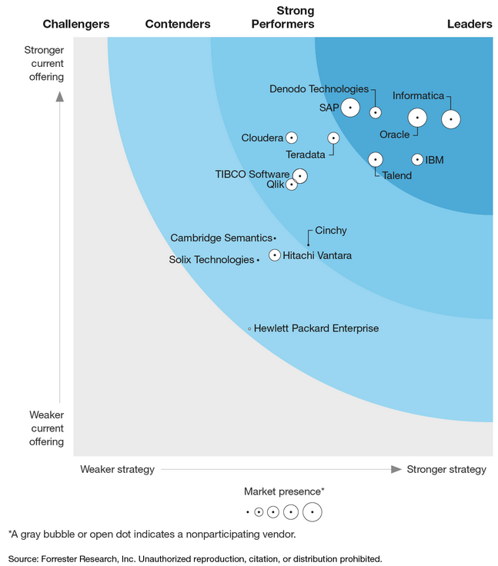
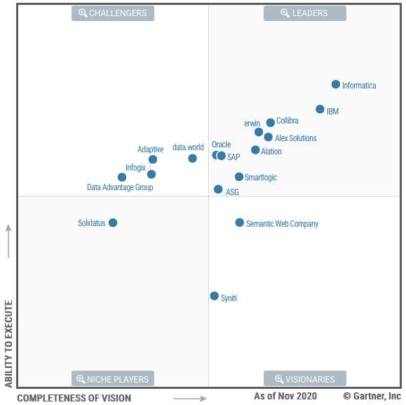
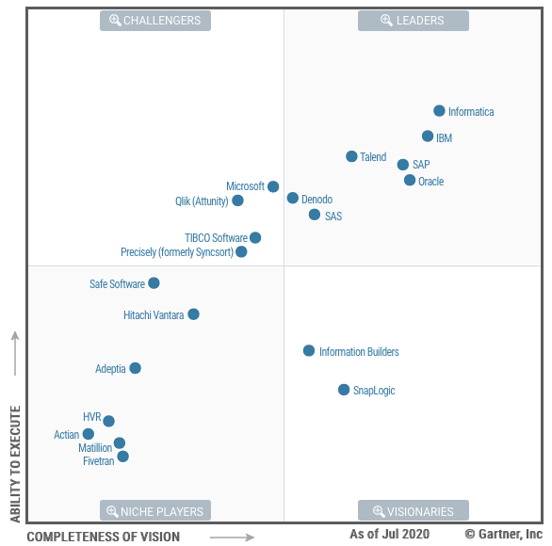
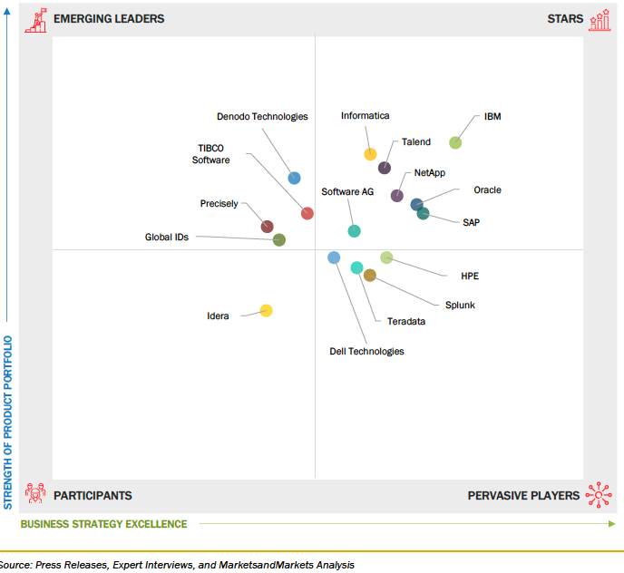
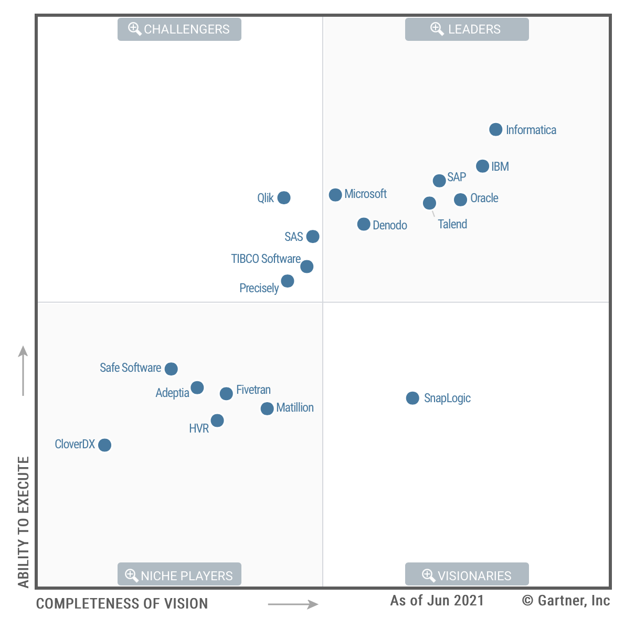
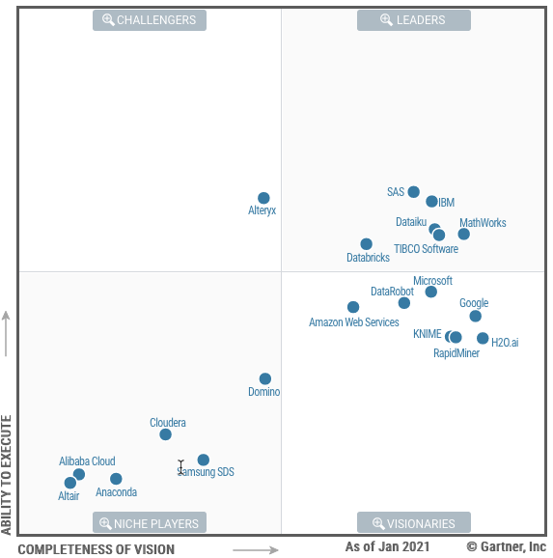
IBM has one of the most complete data fabric solutions in the market
Not for customer-facing use
Forrester Wave Enterprise Data Fabric 2022
Gartner MQ for Metadata Management 2020
Gartner MQ for Data Quality Solutions 2020
M&M Data Fabric Market view 2021
Gartner MQ for Data Integration Tools 2021
Gartner MQ for Data Science Platforms 2021
Notes:
Data fabric spans many different functional areas with many vendors only providing a partial solution. IBM is a strong leader in the data fabric market and the only vendor with a true end-to-end data fabric solution. These are recent analyst reports showing IBMs leadership within the Data Fabric market.
Sources:
Forrester Wave Enterprise Data Fabric 2022: https://reprints2.forrester.com/#/assets/2/73/RES176390/report
Magic Quadrant for Metadata Management Solutions 2020: https://www.informatica.com/metadata-management-magic-quadrant.html?formid=13296&programName=20Q4-C-DPDS-NAM-MUJ-NS-NP-NI-IF-ANRP-GartnerMetadataMQ-0-PT4003-D?cext=search_google_21q1_gartnermetadatamq_na_us_en&ef_id=CjwKCAjw95yJBhAgEiwAmRrutBIiOK6zwdXSrfBQNNkGVtshjeQ_MtsLGNyvQgiW60WbeOE68w2NHBoCrbUQAvD_BwE:G:s&s_kwcid=AL!5237!3!521220678934!p!!g!!data%20fabric&&_bt=521220678934&_bk=data%20fabric&_bm=p&_bn=g&_bg=120853435383&gclid=CjwKCAjw95yJBhAgEiwAmRrutBIiOK6zwdXSrfBQNNkGVtshjeQ_MtsLGNyvQgiW60WbeOE68w2NHBoCrbUQAvD_BwE&gclsrc=aw.ds
Magic Quadrant for Data Integration Tools 2021: https://www.gartner.com/document/4005146?ref=XMLDELV
Magic Quadrant for Data Science Platforms 2021: https://www.gartner.com/document/3998753?ref=XMLDELV
M&M Market View 2021: https://www.marketsandmarkets.com/Market-Reports/data-fabric-market-237314899.html
Magic Quadrant for Data Quality Solutions 2020: https://tdwi.org/whitepapers/2020/10/diq-all-ibm-2020-gartner-magic-quadrant-for-data-quality-solutions.aspx

Slide 29
Notes:
Thank you.

